Slide 1

tourism
Meaning, concept and definition

Slide 2
Definition of traveller, tourism
Traveler: ‘‘any person on a trip between two or more countries or between two or more localities within his/her country of usual residence.’’
Visitors: all types of travellers engaged in tourism
Tourism comprises the activities of persons travelling to and staying in places outside their usual environment for not more than one consecutive year for leisure, business, and other purposes.’’
The term usual environment is intended to exclude trips within the area of usual residence, frequent and regular trips between the domicile and the workplace, and other community trips of a routine character.

Slide 3
Types of tourism
International tourism
Inbound tourism: visits to a country by non-residents
Outbound tourism: visits by residents of a country to another country
Domestic tourism: Visits by residents of a country to their own country
Internal tourism: Visits by residents and nonresidents of the country of reference
National tourism: Internal tourism plus outbound tourism (the resident tourism market for travel agents, airlines, and other suppliers)

Slide 4
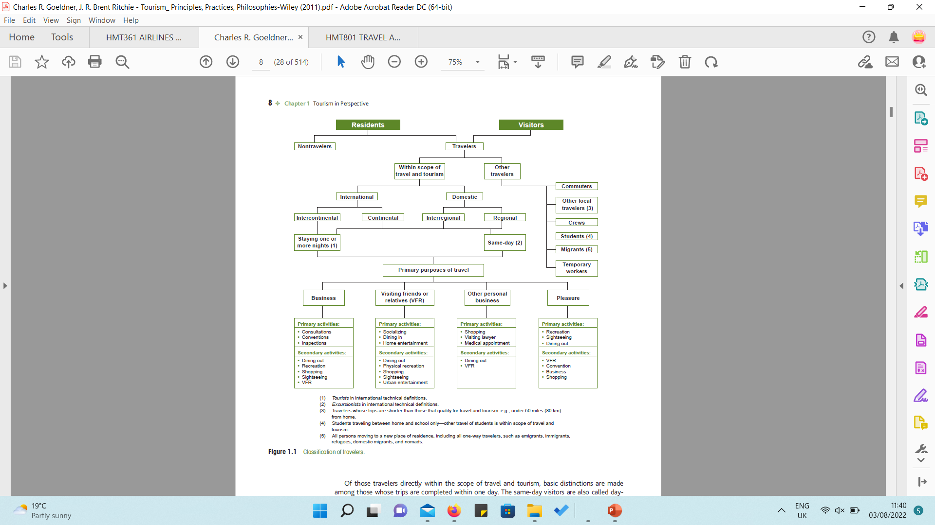
Classification of travellers

Slide 5
Classification of travellers

Slide 6
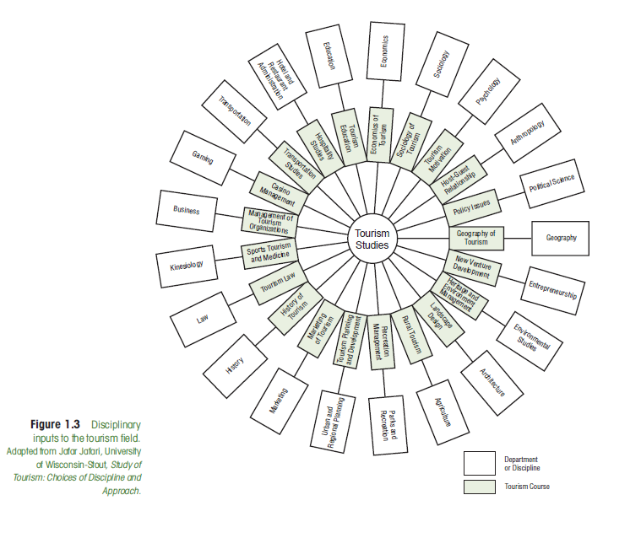
Tourism interdisciplinary model

